Slide 1
Lizards of South America

Slide 2
Lizards of South America
South America is home to a diverse range of lizard species, each with its unique characteristics and adaptations to the various habitats found across the continent. This research explores the fascinating world of South American lizards, highlighting the unique characteristics, habitats, and ecological significance of three remarkable species.

Slide 3
Lizards of South America
South America is home to a remarkable diversity of lizard species, belonging to various families and exhibiting a wide range of morphological and behavioral adaptations. This article provides a brief overview of some of the most notable lizard families found in South America, including the Green Iguana (Iguana iguana), a large and charismatic species known for its vibrant green coloration and impressive size.

Slide 4
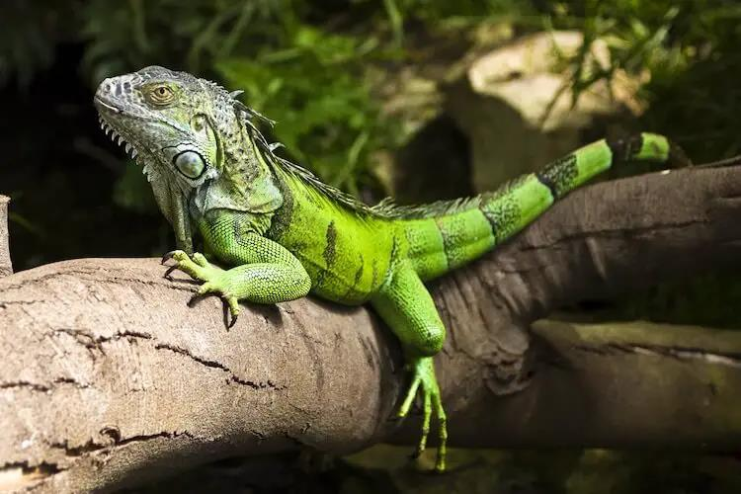

Slide 5
The Tepui Lizard (Pristidactylus urichi) is a captivating and unique reptile inhabiting the Tepui plateaus of South America.
The Caiman Lizard is a captivating reptile native to the tropical regions of South America, particularly found in the Amazon Basin and its surrounding areas. The Tepui Lizard is a captivating and unique reptile inhabiting the Tepui plateaus of South America.

Slide 6
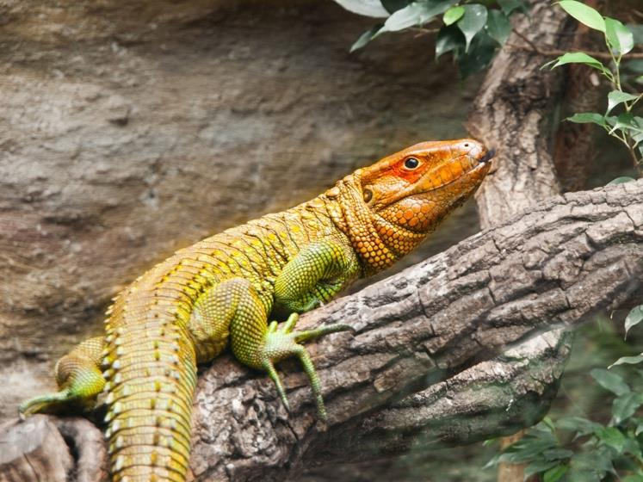

Slide 7
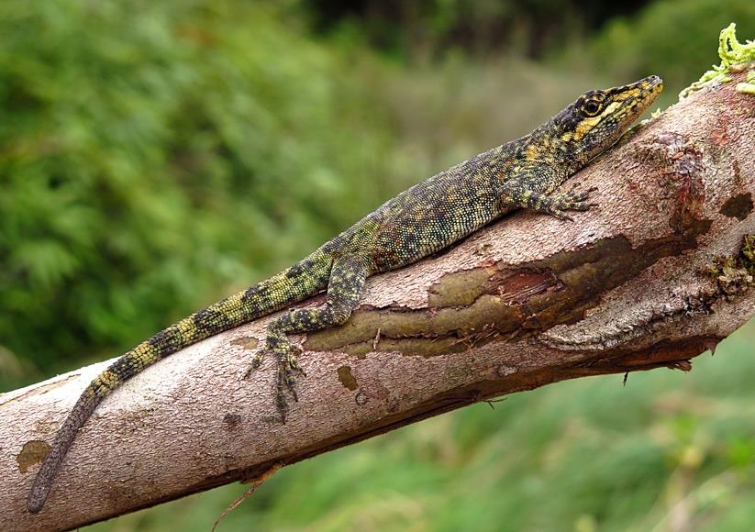

Slide 8
South American Lizards
South American lizards, such as the Green Iguana, Caiman Lizard, and Tepui Lizard, are essential components of the continent's rich biodiversity. They face various threats, including habitat loss, illegal pet trade, and climate change, which impact their survival and wellbeing. Conservation efforts are crucial to safeguarding these captivating creatures and the vital roles they play in their respective ecosystems.

Slide 9
South American Lizards
South America is home to an array of lizards, ranging from small geckolike creatures to large monitor lizards. These reptiles play a vital role in maintaining ecological balance in their respective habitats. However, they are threatened by various factors such as habitat loss, climate change, and illegal trade. Responsible research, education, and community involvement are necessary to conserve their habitats and promote their welfare.

